Slide 1
TAC Outreach Call
April 14, 2015
DoD Integrated Lodging Pilot Program
Presenters:
Barbara McGeorge, Moderator
Dan Greene, TAC Outreach Call Coordinator

Slide 2
Agenda
Top Issues for March/April
DoD Integrated Lodging Pilot Program
  Overview
  Policy
  DTS Functionality
    Lodging Button
    New Lodging Tabs
    Multi-Location Links
    Automated Certificate of Non-Availability
    New Pre-Audits and Reason Codes
    New BI and Reporting Tool Reports
Questions
Resources
2

Slide 3
Top Issues for March/April
Issue # | Type | Problem | Workaround | Target Release
DTSP-8283 | SPR | An amendment to a document does not link up with the original. This causes the Approving official to receive a message saying “Document is currently open and being edited by another user”. | The document must be abandoned. Please contact the TAC so that the issue can be verified and properly handled. | FY15-Maint-Rel-3
DTSP-8427 | SPR | Trip Types of 12 – 24 Hours with Lodging do not allow the adjustment of Lodging Costs. | The trip duration must be changed to Multi-Day. | FY15-Maint-Rel-3
DTSP-8541 | SPR | DTS Budget is not de-obligating when a voucher is submitted with a trip cost lower than the original authorization obligation. | The local organization must take the appropriate action to handle the necessary adjustments to the DTS Budget Module. | Ready For Assignment
Information on SPRs, SCRs, Infrastructure SPR/SCRs, and Archived SPR/SCRs can be found in the SIM Report on Trax.
If you would like access to the SIM Report, please submit a TAC Ticket requesting access.

Slide 4
Integrated Lodging Program Overview
The National Defense Authorization Act for FY15 (P.L. 113-291) empowered the Secretary of Defense with the authority to institute a government lodging program
  That authority directs both DoD civilian employees and members of the Military Services under the Secretary’s jurisdiction to stay in government or preferred commercial lodging while on official travel.
As a first step toward a larger program, DoD will conduct an Integrated Lodging Program Pilot that:
  Integrates the ability to book DoD lodging in DTS
  Tests the viability of an enterprise–wide preferred commercial lodging program
  Directs travelers to use government or preferred commercial lodging at select pilot sites

Slide 5
Integrated Lodging Program Overview (continued)
The Integrated Lodging Program will:
  Ensure that travelers are staying in quality lodging facilities that are close to TDY locations, are protected from certain fees, and provide amenities at no additional cost with room rates below the per diem.
  Enhance traveler care and satisfaction, provide greater traveler security, reduce lodging spend per night, and improve program management and data collection.

Slide 6
JTR Policy Changes PENDING
Travelers with TDY orders to select pilot sites are directed to stay in government (DoD) or preferred commercial lodging facilities and use DTS or a CTO (when DTS is not available) to book their stay
  DoD Lodging (TDY to installation)
  DoD Preferred (TDY to metro area or DoD Lodging not available)
    If available and not used, reimbursement is limited to the amount the Government would have paid if the traveler stayed in either DoD or Preferred lodging
      Unless exception applies
      AO may authorize exception to use based on mission, distance, lower rate, etc.
Exceptions:
  Very high ranking travelers (flag officer, SES)
  One-night stay
  Per approved “Reason Codes” (more later)
Notes:
This change requires civilians to stay in government lodging when TDY to a pilot site and secure a CNA if not available.

Slide 7
JTR Policy Changes (continued) PENDING
If orders list the TDY location as a U.S. military installation:
  Traveler must book government lodging if available
  If available and traveler chooses other accommodations, lodging reimbursement is limited to the cost of available government lodging
  If government lodging is not available, travelers are directed to book preferred commercial lodging if available

Slide 8
JTR Policy Changes (continued) PENDING
If orders list the TDY location as pilot site city or metropolitan area:
  Traveler is directed to book preferred commercial lodging if available
  If preferred commercial lodging is available and traveler selects other lodging, lodging reimbursement is limited to the highest amount for preferred lodging in that area unless available military lodging has been declined

Slide 9
ILP Pilot Locations
Charleston, NC (military installation: Joint Base Charleston)
Dayton, OH (military installation(s): Wright Patterson Air Force Base)
Tampa, FL (military installation(s): MacDill Air Force Base)
Twentynine Palms, CA (military installation(s): Marine Corps Air Ground Combat Center)
Saratoga Springs, NY (military installation(s): Naval Support Activity Saratoga Springs)
Seattle-Tacoma International Airport Area, WA
Norfolk Area, VA (military installation(s):
  Naval Station Norfolk
  Naval Air Station Oceana, Dam Neck
  Joint Expeditionary Base Little Creek-Fort Story
  Naval Medical Center Portsmouth
  Naval Shipyard Norfolk/Portsmouth
  Naval Support Activity Hampton Roads VA - Northwest Chesapeake)

Slide 10
Available Lodging Types
DoD Lodging
  Government-owned, usually Government-managed
  Usually on installation
Commercial Lodging
  Commercially-owned and managed
  Usually off installation
  Three varieties (next slide)

Slide 11
DoD Lodging
Installations with DoD Lodging connected to DTS
Travelers can book DoD lodging in DTS for all available installations (including those at non-pilot sites)
USN & USAF installations
USA installations in foreign OCONUS & Charlottesville, VA
Future: USMC installations

Slide 12
Commercial Lodging Types
DoD Preferred
  Selected providers in high-volume markets
  Meet specific quality standards
  Signed agreement to provide services and amenities at low negotiated rates
  For TDY DoD travelers only
Other Safety Compliant
  FEMA safety certified
  No signed agreement
Other Published Rates
  All other lodging providers
  May not comply with safety standards

Slide 13
Lodging Selection Order For Pilot
If directed lodging is not available or exception applies, select next available option
  May choose previous option if available
Order | Lodging Type | First Choice if…
1 | DoD | TDY to pilot location installation (directed)
2 | DoD Preferred* | TDY to pilot location metro area (directed)
3 | Other Safety Compliant* | TDY not to pilot location
4 | Other Published Rates* | Never first choice
Order | Lodging Type | First Choice if…
1 | DoD | TDY to pilot location installation
2 | DoD Preferred* | TDY to pilot location metro area (directed)
Order | Lodging Type | First Choice if…
1 | DoD | TDY to pilot location installation (directed)
Order | Lodging Type | First Choice if…
*Commercial lodging option

Slide 14
New DTS Functionality
DTS will be modified to facilitate the Integrated Lodging Program:
  Lodging button removed (when TDY to pilot locations)
  2 new tabs in the Lodging portion of the Res Mod
    DoD Lodging (new)
    DoD Preferred Lodging (new)
    Other Safety Compliant Lodging
    Other Published Rates
  Automated Certificate of Non-Availability (CNA)
  Multi-location TDY Links
  New pre-audits and reason codes
  New reports in the BI and reporting tool

Slide 15
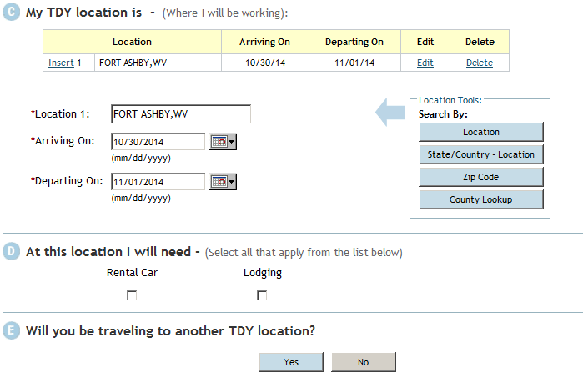
Creating DTS Authorization
NORFOLK, VA
NORFOLK, VA
Lodging Checkbox will be removed from this screen.

Slide 16
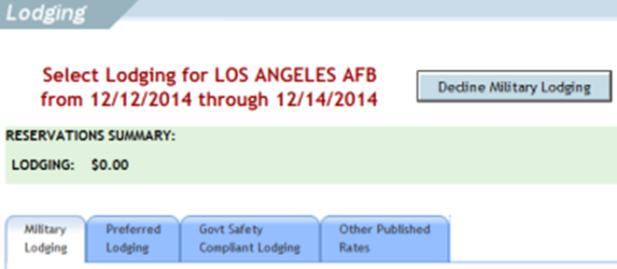

Lodging Tabs
Government
  DoD
Commercial
  DoD Preferred
  Other Safety Compliant
  Other Published Rates

Slide 17
DoD Lodging
If the TDY location is a US Installation with DoD lodging, this tab will be enabled
Facilities are connected with the Defense Lodging System (DLS)
If available, use is required to receive full reimbursement of lodging costs up to the locality lodging rate unless JTR exemptions apply
  Travelers will receive a pre-audit flag that requires reason codes and justifications if they do not utilize this type of lodging

Slide 18
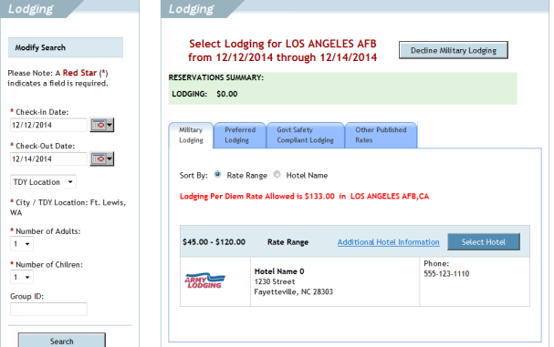
DoD Lodging

Slide 19
DoD Lodging
The Search in the DoD Lodging tab will be modified to include Number of adults, children and Group ID.

Slide 20
DoD Lodging
Travelers can select the hotel by hitting the “Select Hotel” button.

Slide 21
DoD Lodging
The DoD Preferred Lodging, Other Safety Compliant Lodging and Other Published Rates will be disabled to prevent the traveler from navigating to them.

Slide 22
DoD Lodging
If the traveler wishes to decline the DoD Lodging, they will receive a Pre-Audit Flag that requires a Reason Code and Justification.

Slide 23
Failure to Connect and Other Errors
Two scenarios:
  DTS cannot establish link with lodging facility
    DTS enables CTO assistance and alternate lodging tab
    DTS disables cost reimbursement limits
    Traveler options are:
      Try again later
      Contact CTO
      Call facility directly
  Link established, but other error registered
    DTS will allow the use of the CTO assistance button, but will keep the alternate lodging tabs disabled
    Traveler options are:
      Troubleshoot by calling the TAC
      Request CTO Assistance
      Try again later

Slide 24
DoD Preferred Lodging
This tab will be available if…
  The TDY location has a preferred vendor
  The traveler declined DoD Lodging
  DoD Lodging is not available
If available, use is required to receive full reimbursement of lodging costs up to the locality lodging rate unless JTR exemptions apply
  Travelers will receive a pre-audit flag that requires reason codes and justifications if they do not utilize this type of lodging

Slide 25
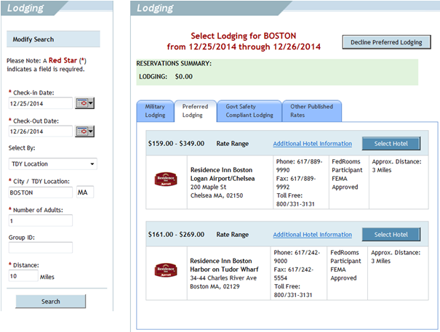

DoD Preferred Lodging
DoD Preferred
DoD Preferred

Slide 26
DoD Preferred Lodging
DoD Preferred
The search will be modified with 2 new fields:
Number of Adults
Group ID
DoD Preferred

Slide 27
DoD Preferred Lodging
DoD Preferred
Travelers can select the hotel by hitting the “Select Hotel” button.
DoD Preferred

Slide 28
DoD Preferred Lodging
The DoD Lodging Tab will still be available should the traveler want to go back to select that type of lodging.
DoD Preferred
DoD Preferred

Slide 29
DoD Preferred Lodging
The Other Safety Compliant Lodging and Other Published Rates will be disabled to prevent the traveler from navigating to them.
DoD Preferred

Slide 30
DoD Preferred Lodging
If the traveler wishes to decline the DoD Preferred Lodging, they will receive a Pre-Audit Flag that requires a Reason Code and Justification.
DoD Preferred
DoD Preferred

Slide 31
Other Safety Compliant Lodging
This tab will be available if:
  Both DoD Lodging and DoD Preferred Lodging were unavailable
  Both DoD Lodging and DoD Preferred Lodging were declined
  One type was unavailable and one declined
  One type was unavailable and one does not exist
This tab provides hotels that are:
  Fire safe
  FEMA certified

Slide 32
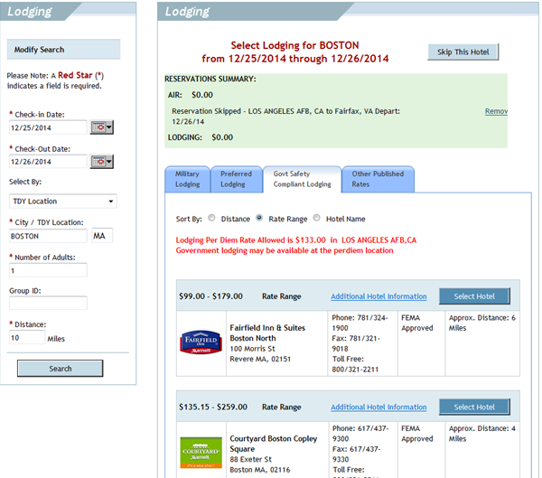

Other Safety Compliant Lodging

Slide 33
Other Safety Compliant Lodging
The search will be modified with 2 new fields:
Number of Adults
Group ID

Slide 34
Other Safety Compliant Lodging
Travelers can select the hotel by hitting the “Select Hotel” button.

Slide 35
Other Safety Compliant Lodging
The DoD Lodging and DoD Preferred Lodging Tabs will still be available should the traveler want to go back to select that type of lodging.

Slide 36
Other Safety Compliant Lodging
The Other Published Rates Tab will be disabled to prevent the traveler from navigating there.

Slide 37
Other Published Rates
This tab will only show if:
  Both DoD Lodging and DoD Preferred Lodging were unavailable
  Both DoD Lodging and DoD Preferred Lodging were declined
  One type was unavailable and one declined
  One type was unavailable and one does not exist
AND
  Other Safety Compliant Lodging is not available
These rooms are considered to be a last resort only

Slide 38
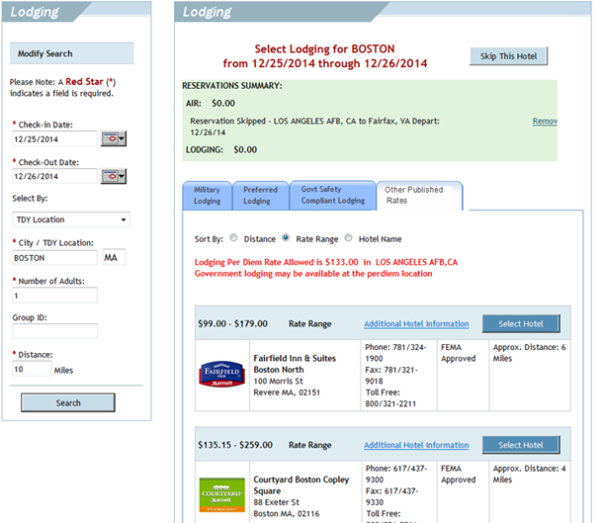

Other Published Rates

Slide 39
Other Published Rates
The search will be modified with 2 new fields:
Number of Adults
Group ID

Slide 40
Other Published Rates
Travelers can select the hotel by hitting the “Select Hotel” button.

Slide 41
Other Published Rates
The Other Safety Compliant Lodging Tab will be disabled automatically.

Slide 42
Other Published Rates
The DoD Lodging and DoD Preferred Lodging Tabs will still be available should the traveler want to go back to select that type of lodging.

Slide 43
Special Consideration For Long-Term TDY
Reduced per diem rates may apply on long-term TDY
  DoD Preferred
    Decline if all rooms are over lodging per diem limit
    Justify with need to stay within per diem rate
  No change
    DoD – reduced per diem does not apply
    Other Safety Compliant – no auto reimbursement limit
    Other Published Rates – no auto reimbursement limit

Slide 44
Automated CNA
The Joint Travel Regulations (JTR) requires uniformed service members on orders to a U.S. Installation (as opposed to a geographic location like a town or city) to check for Government quarters availability at the site to which they are temporarily assigned
  A pending JTR change will extend this requirement to DoD civilians TDY to pilot sites
If on base lodging is not available, the traveler will be issued a CNA
Once a CNA is issued, the traveler has no requirement to check lodging availability at a later date during the TDY period

Slide 45
Automated CNA
If there is no DoD Lodging available when the traveler is making reservations, a CNA will be generated automatically
Traveler will be notified first on the Reservation Module screen
  The CNA will be present on the Preview Trip screen
  A Pre-Audit Advisory will also be created with the CNA

Slide 46
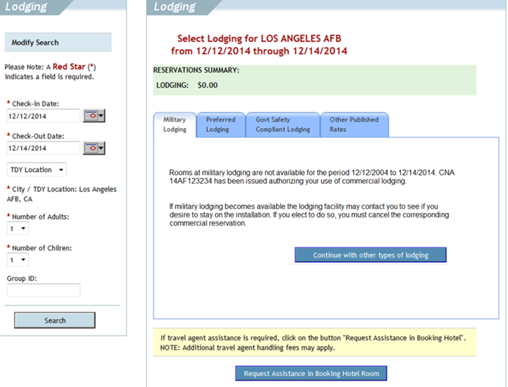
Automated CNA (Reservation Module)

Slide 47
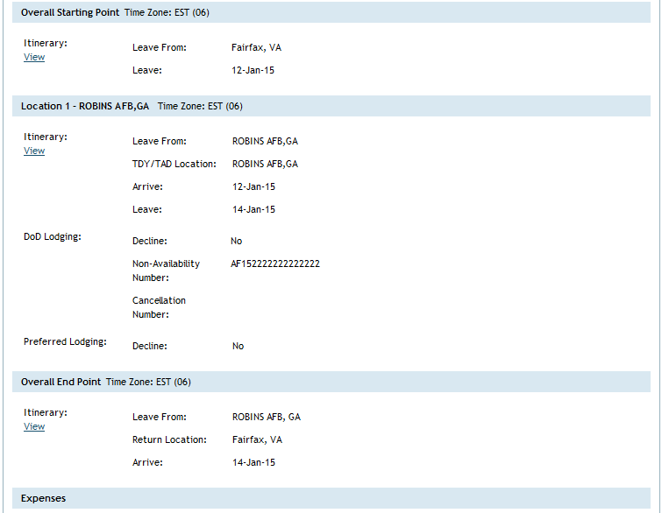
Automated CNA (Preview Trip Screen)

Slide 48
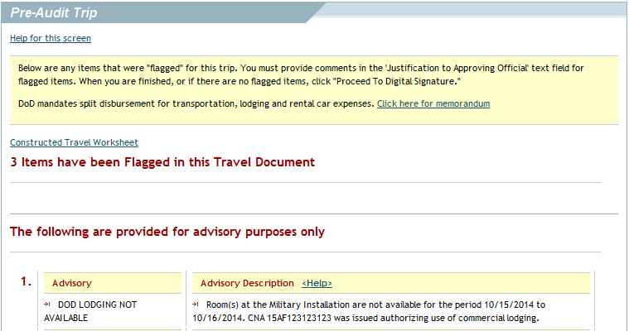
Automated CNA (Pre-Audit Advisory)

Slide 49
Modify Lodging on Multi-Location TDY
DTS will also be modified with the addition of location-specific links when the trip contains multiple TDY Locations
When a traveler returns to the Lodging screen to add, remove, or modify lodging reservations, if the trip has multiple destinations, before the Lodging screen opens DTS will display a link for each TDY location
Selecting a link populates the Lodging screen with the current reservation information for that location

Slide 50
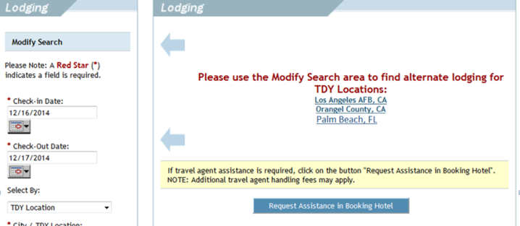
Modify Lodging on Multi-Location TDY

Slide 51
Pre-Audits, Reason Codes, and Advisories
Pre-Audits
  AVAIL DOD LDG NOT USED*
  AVAIL PREFERRED LDG NOT USED*
  LODGING NOT USED*
  GOVT SAFETY REG NON-COMPLIANT
  *Requires Reason Code selection
Advisories
  DOD LODGING NOT AVAILABLE
    Provides CNA
  DOD LODGING CONNECTION ERROR
  PREFERRED LDG NOT AVAIL

Slide 52
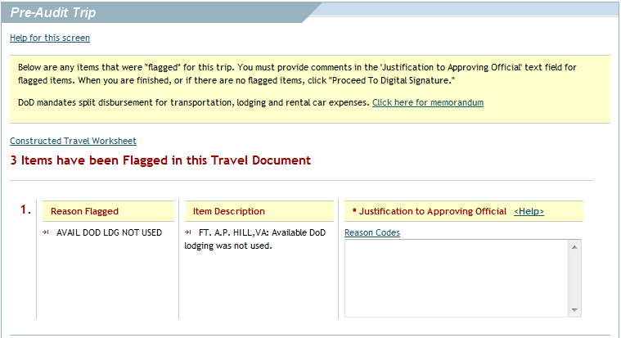
Pre-Audit

Slide 53
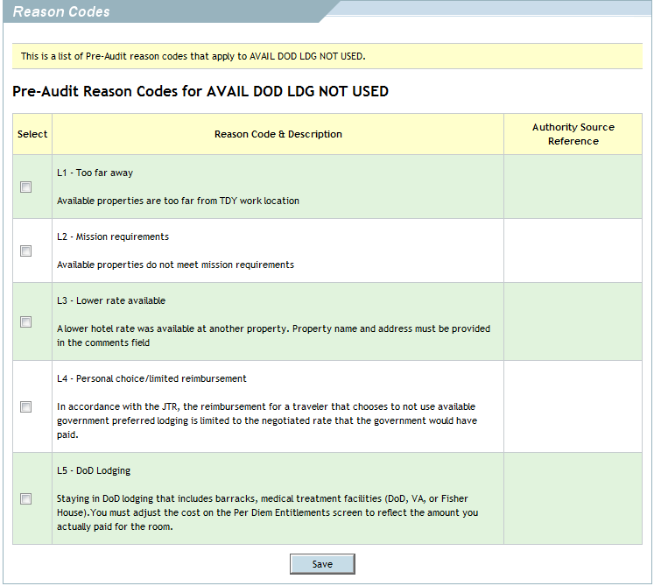
Reason Codes

Slide 54
Reason Codes
Distance
Conference/Event
Used contracted lodging
Lower rate
Used DoD lodging
CTO assistance needed
JTR exemption
Used rental lodging
Lodging w/ family/friends
Personal choice
Mission requirement

Slide 55
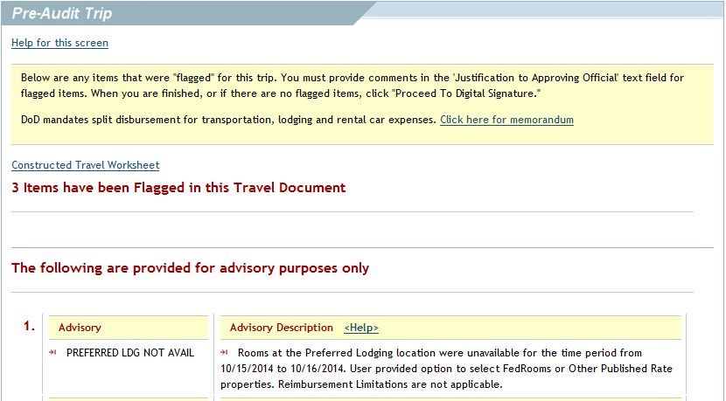
Advisories
Rooms at properties in the preferred commercial lodging program are not available at the TDY location for the time period from <check-in> to <check-out>. User provided option to select Government Safety Compliant or Other Published Rate properties. Reimbursement Limitations are not applicable. (CCB Approved text for PLDGUC12 (3.2.01.01.02.13.03.17.02.02))

Slide 56

New Reports in the BI and Reporting Tool
Lodging-related reports added to BI and Reporting Tool
  DTS Welcome Screen > Reports > BI and Reporting Tool

Slide 57
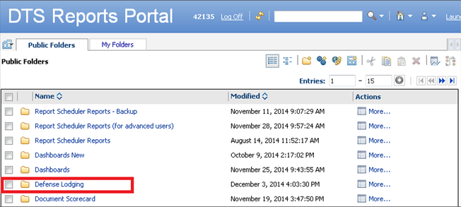
New Reports in the BI and Reporting Tool
Lodging-related reports added to BI and Reporting Tool
  Public Folders > Defense Lodging folder

Slide 58
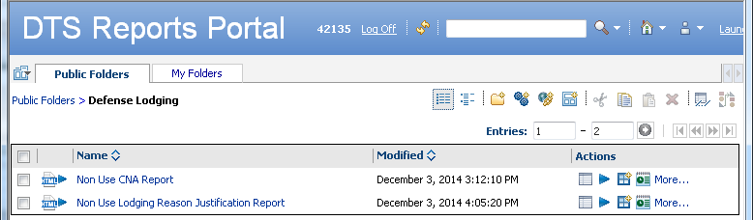
New Lodging Reports
No special permissions required
Run using standard BIRT functionality
Non Use CNA Report
  Directed DoD lodging not available
Non Use Lodging – Reason Justification Report
  Available, directed lodging not used

Slide 59
Questions
59
59

Slide 60
Resources
Travel Lodging Look-Ahead (L200) Distance Learning
  https://www.defensetravel.dod.mil/passport/
You can contact the Travel Assistance Center (TAC) via:
  Phone 888-Help1Go (888-435-7146)
  Web (https://www.defensetravel.dod.mil/passport/)
60

